Slide 1
ANTHROVOLT
Engineered to Empower

Slide 2
INTRODUCTION
AnthroVolt is a rehabilitation device designed to aid in restoring and improving forearm mobility and muscle strength. It plays a crucial role in physiotherapy for patients recovering from fractures, muscle injuries, or neurological conditions that affect limb movement. By providing controlled, repetitive motion, AnthroVolt helps enhance joint flexibility, coordination, and muscular endurance. The device encourages active patient participation, making therapy more engaging and effective. In addition to therapeutic benefits, the system converts mechanical motion into electrical energy, making it a sustainable and innovative solution for medical rehabilitation centers and hospitals.

Slide 3
WORKING PRINCIPLE
AnthroVolt works on the principle of converting mechanical energy into electrical energy using human motion. When the user moves the handle up and down, the shaft transfers motion to a generator, producing electricity based on Faraday’s Law of Electromagnetic Induction. An Arduino is integrated to track and record movement, monitoring speed, count, and efficiency. This makes AnthroVolt useful for forearm rehabilitation, muscle training, and sustainable energy generation.

Slide 4
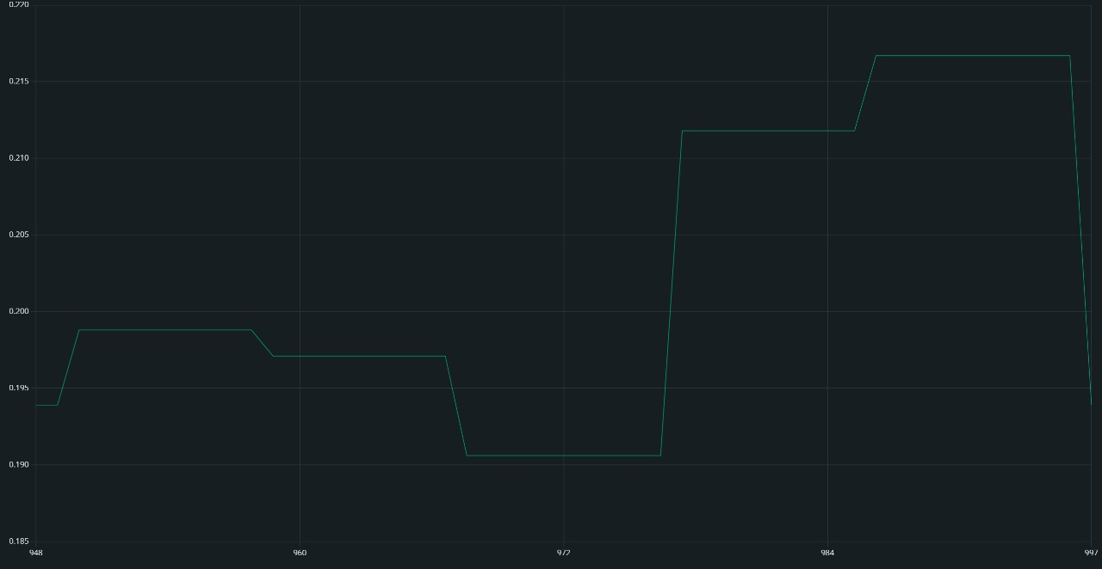
AMPLITUDE
How far and strongly the wrist is moving
low amplitude – stiffness or reduced wrist mobility

Slide 5
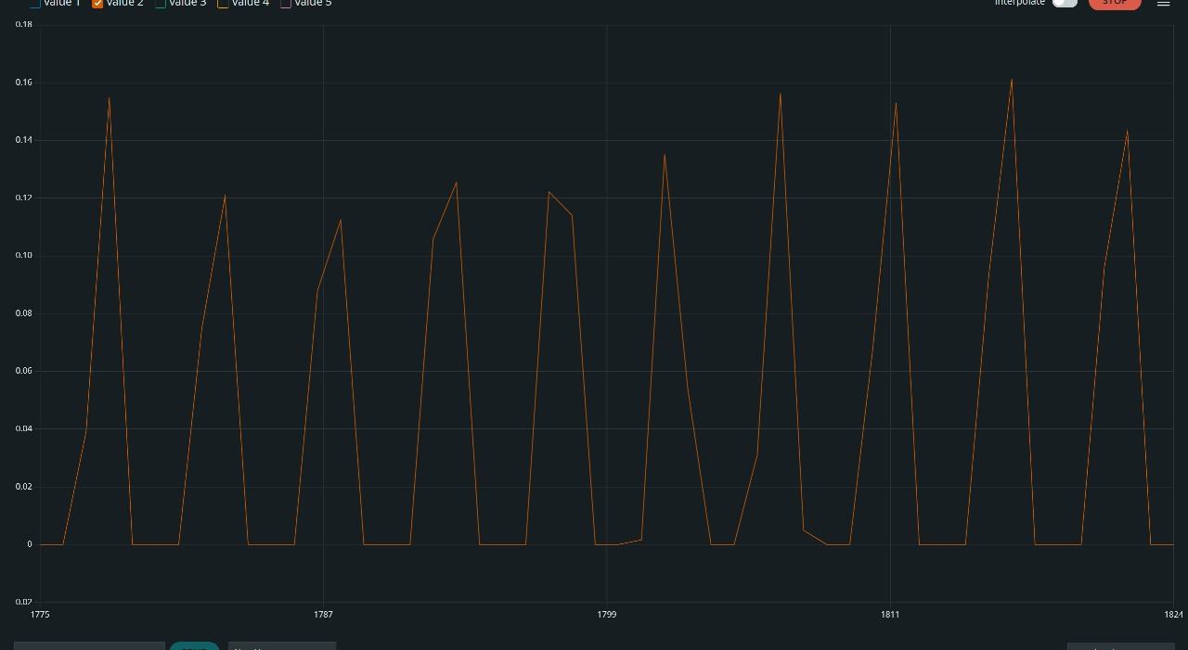
VOLTAGE
Indicates the raw voltage signals
low voltage – restricted wrist movement

Slide 6
SMOOTHNESS
Indicates stability of motion based on signal variance
low smoothness – jerky ,uncoordinated movement

Slide 7
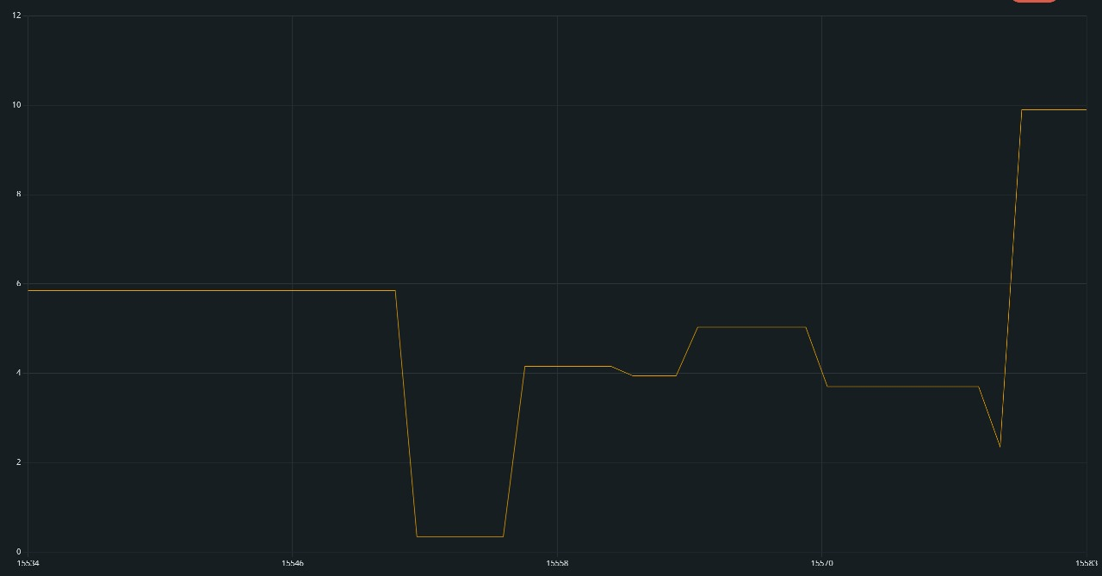
FREQUENCY
Indicates speed of wrist oscillation
low frequency – poor control or tremor

Slide 8
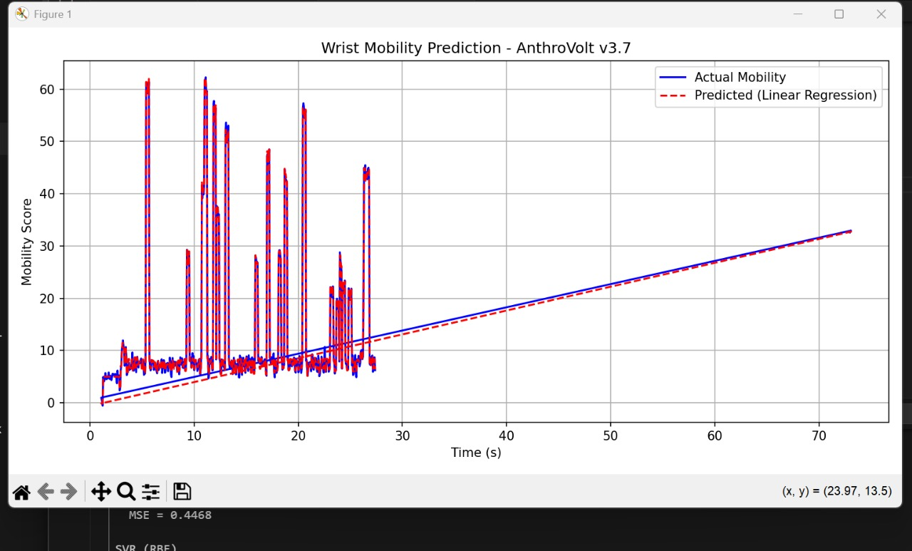
CONCLUSIONS
Higher peaks → larger or faster wrist movements
Flat or low areas → stillness or slow motion

Slide 9
CONCLUSIONS
Blue Line – Actual Mobility (from Arduino):This is the true measured mobility of your wrist, directly derived from the sensor signal (after filtering and feature extraction).Notice the spikes between 5–25 seconds → these are bursts of active wrist movement.The flat regions indicate rest or minimal motion.
Red Dashed Line – Predicted Mobility (Linear Regression):This is the machine learning model’s prediction based on live data.It follows the blue line closely, meaning the model successfully learns and tracks wrist motion patterns.The tight overlap of red and blue lines indicates high accuracy and reliability.

Slide 10
CLINICAL DIAGNOSTICS
Here’s how you can explain its diagnostic value: "Each spike corresponds to a wrist flexion–extension cycle. Regular, consistent spikes = healthy joint mobility. Irregular amplitudes or missing spikes = possible stiffness, tremor, or restricted range. ”The model can serve as a digital biomarker to track progress during physiotherapy, detect fatigue, or monitor post-surgery recovery.”

Slide 11
APPLICATIONS
Sports Training: Enhances forearm strength, grip, and endurance through repetitive motion. It also helps athletes track motion and power output using Arduino sensors.
Medical Rehabilitation: Assists patients in regaining forearm mobility after injury or surgery, providing controlled exercise and measurable recovery feedback.
Sustainable Energy Source: Converts human motion into electricity, enabling charging of small devices while exercising, thus promoting eco-friendly energy use.

Slide 12
FUTURE SCOPE
Future versions can include advanced sensors and IoT connectivity for real-time performance tracking.
Improved ergonomic design can make it suitable for all age groups and medical conditions.
Energy output can be enhanced to power more devices efficiently.
Integration with mobile apps can monitor progress and energy generated.
The concept can expand into full-body rehabilitation and energy-harvesting fitness equipment.

Slide 13
TEAM MEMBERS
SARTHAK BHARTI (240938)
AAYUSHMAN TRIPATHI (240025)
BHARGAVI BORSE (240284)
AKSHAT KASARWAL (240085)
SHAMBHAVI SINGH (240958)
HARSHIT DASHORE (240439)
PRIYANSHU JOSHI (240806)
UTKARSH SINGHAL (241119)

